Slide 1
Lesson 1.2
HTML Development environments

Slide 2
Learning Outcomes
Set up your online development environment
Use an Integrated Development Environment to build your first HTML project

Slide 3
Development Environments
Code editors are tools used by programmers and web developers to write and edit code
Make coding faster and easier
Features: auto-completion, syntax highlighting, indentation, collaboration, etc.
Online development environment
https://codepen.io/
Good for smaller assignments (< 20 lines)
Local development environment
VS Code, Notepad++, etc.
Good for larger assignments (> 20 lines, multiple files)

Slide 4
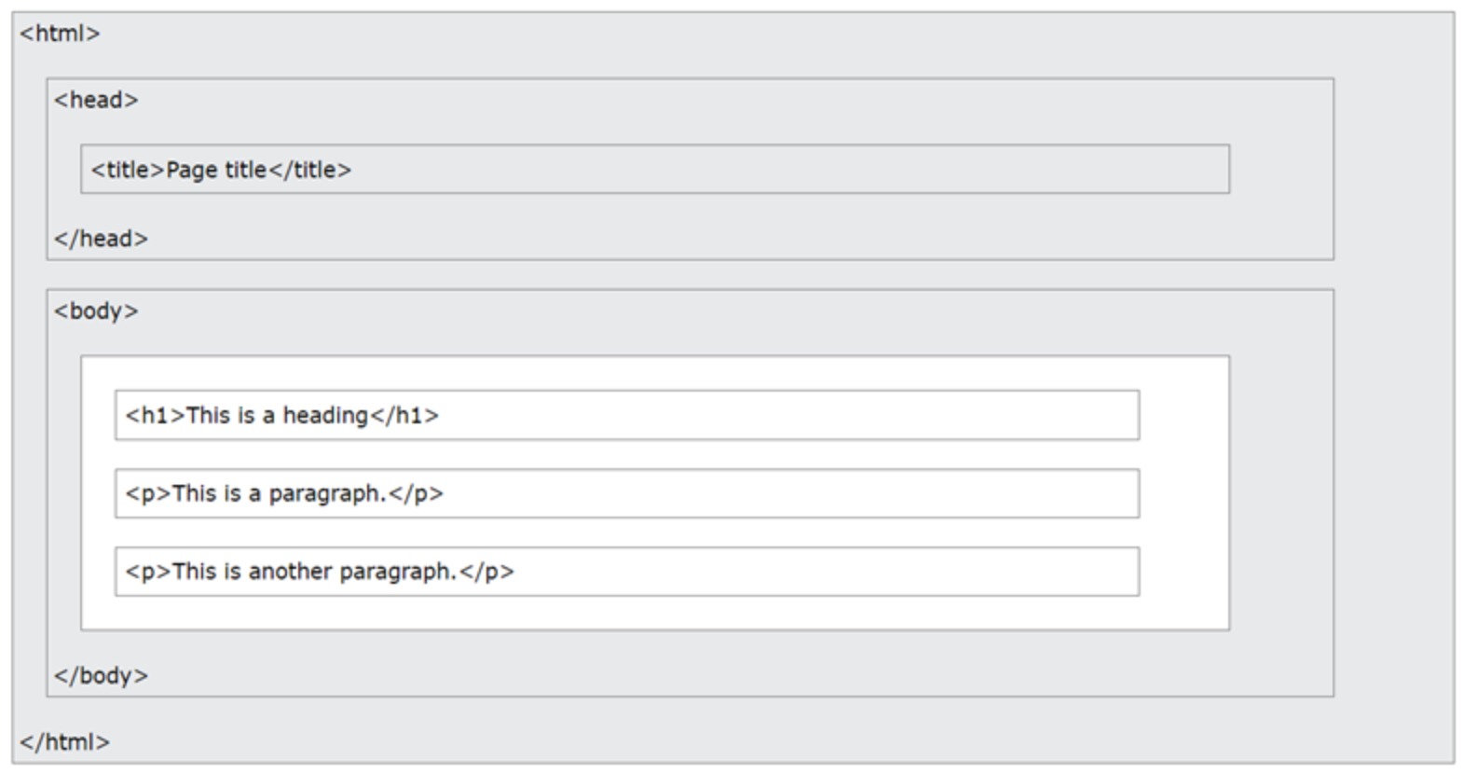
HTML Page Structure

Slide 5
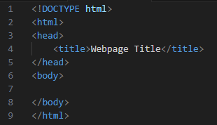
Simple HTML Boilerplate
<!DOCTYPE html>
Specifies that this is an HTML5 document
<html></html>
Root element of an HTML page
<head></head>
Contains the page’s meta information
<title></title>
Gives the HTML page a title
<body></body>
Specifies the page’s body and serves as a container for all visible information

Slide 6
Web Browsers
HyperText Markup Language is a markup language that tells web browsers how to structure the web pages you visit.
The purpose of a web browser is to read HTML documents and display them correctly.
E.g. Chrome, Edge, Firefox, Safari
A browser does not display the HTML tags. It uses them to determine how to display the document.

Slide 7
Simple HTML Page Example
VS Code
‘Live Server’ extension
CodePen
CodePen strips out the boilerplate code, and just leaves you with the <body> tag ready for your content

Slide 8
Practice Activity
Using VS Code, create a webpage with the following content:
Title = [your name]
Body contains the following elements:
Heading that reads “Hello World!”
Paragraph that reads “This is my first webpage in TECH1101.”
Using CodePen, create a webpage with the following content:
Body contains the following elements:
Heading that reads “Hello World!”
Paragraph that reads “This is my first webpage in TECH1101.”

Slide 9
For next class
Read Lesson 1.3
Do Learning Activity 1.3.1
Assessments Reminder:
Engagement is worth 10% of your final grade. Engage by sharing code, asking or answering questions, etc.
All assessment dates have been posted in the D2L calendar.
See the “Assignments Policy” for late submission procedures.

Slide 10
References
Introduction to HTML (w3schools.com)
Getting started with HTML - Learn web development | MDN (mozilla.org)

